Slide 1
Renotech R&D Ash2Cash
Concept
Novel Binders from Ash
Valter Wigren
Renotech R&D

Slide 2
Outline
Part 1:
Biomass and mixed ashes – Properties and Opportunities
  Variation in fuel ash compositions
  Variation Industrial biomass ashes
  Ash classification and binder properties
Part 2:
Renotech Ash2Cash Concept
  In-situ high temperature chemical modification of ash chemistry
  Mechanochemical activation and mixing
  Piloting concept
  Status
  References

Slide 3
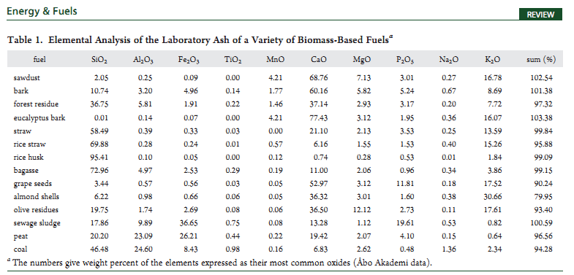
Elemental Composition of Ashed Fuels
Ash content
0,2-1,5%
5-15 %
From Werkelin et al. 2012 Åbo Akademi
Woody biomass: Large quantities of Ca and K and low in Si and Al
Coal and Peat: Large quantities of Si,Al,Fe, Lower in Ca, K

Slide 4
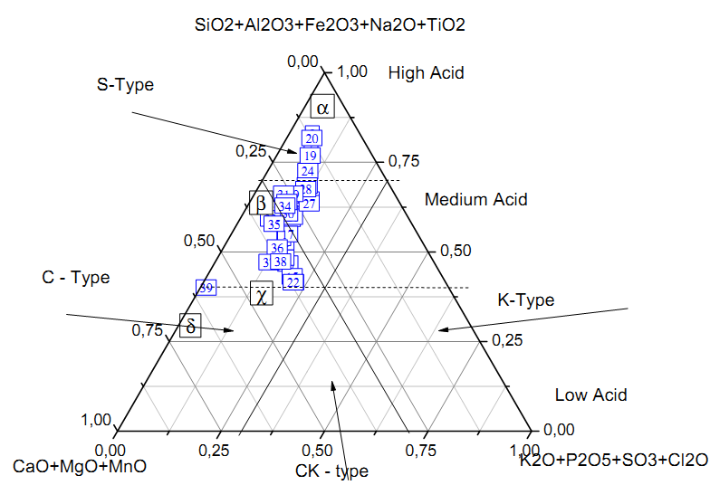
Composition of Industrial Samples
α = Class F Fly Ash
β = Class C Fly Ash
γ = Oil shale/ Brown coal Ash
δ = Cement
Increasing CS
Samples from Biomass-Peat powerplants mainly silica rich in contrast of fuel analyses
High contents of Silica results from differences in ash content of fuels (Peat = 8-12 % vs Wood 0,5-3%) And escape of bed material (pure silica to ash)
Ash types from: Vassiliev et al. 2011

Slide 5
Reactivity Classes for Biomass Ashes
Name of Class | Mineralogy | Binder Potential | Typical Fuels
H-Ca-H-SO3 (>25 p% CaO, >5 % SO3) N = 20 % | Storng peaks of: CaSO₄-CaO>Gehl>SiO₂ CaSO₄ – Highest intensity | Compression strenghs of over 5 MPa is extremely likely | Bark, woody fuels or Ca-rich byproducts
H-Ca-L-SO3 (>25 p% CaO, <5 % SO3) N = 25 % | CaO - CaSO₄ >Gehl>SiO2 CaO on equal level with CaSO₄ | Compression strenghs of over 1 MPa is extremely likely | Peat levels at < 30 wt%. Possible Ca-rich byproducts
M-Ca-H-SO3 (15-25 p% CaO, >5 % SO3) N = 5 % | SiO2-Fe2O3-CaSO4-CaO Ca – phases on equal level with Si and Fe rich phases | Possible hydralic activity | Peat levels > 40 %
M-Ca-L-SO3 (15-25 p% CaO, >5 % SO3) N = 35 % | SiO2-Fe2O3-CaO –phases > CaSO4-CaCO₃ Ca – phases on equal level with Si and Fe rich phases | Possible hydralic activity | Peat levels > 40 %
L-Ca ( < 15 p% CaO, SO3 < 5 p%) N = 15 % | SiO2-Fe2O3 -faaseja Undetectable levels of Ca phases | No hydralic activity | Mostly Peat
Compression Strenghts with High Ca ashes a high as 20 – 30 MPa

Slide 6
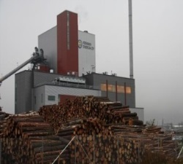

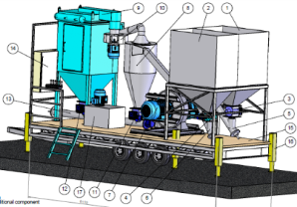
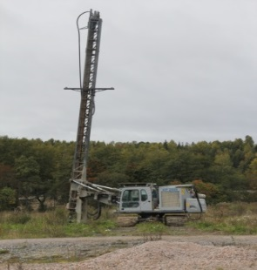
Ash2Cash Concept
Ash Chemistry:
In-situ upgrading of ash reactivity during combustion and in-field modifications
Logistics:
Optimizing transport routes, storage options and production amounts
Ash Chemistry
In-field recepts:
Ash-cement/lime mixture recipies for different applications
EkoMill
Economy
Ash2Cash
Formulations

Slide 7
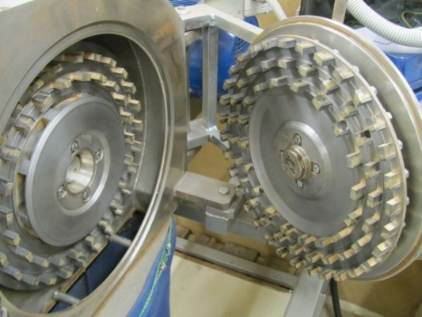
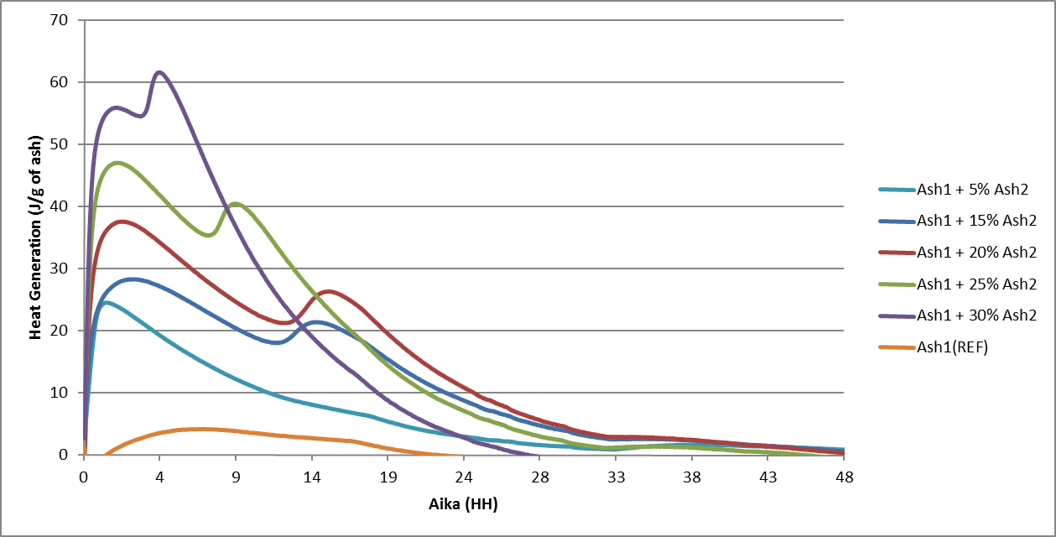
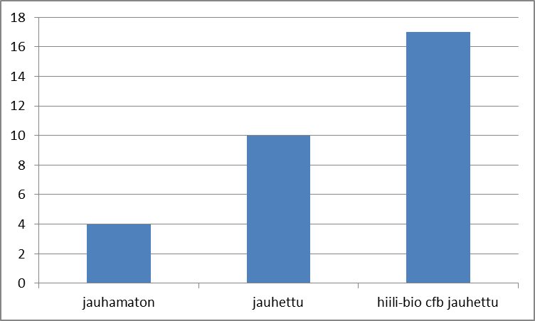
Mechanochemical Activation
High intensity GRINDING enhances binder quality
Grinding can be done with different mixtures or chemical activators to CONTROL reactivity
Co-Grinding possibilities to make OPTIMUM Blends of different materials, such ass Biomass ash, GGBS, FGD etc.
Desintegrator activation
Activity monitoring
effects

Slide 8
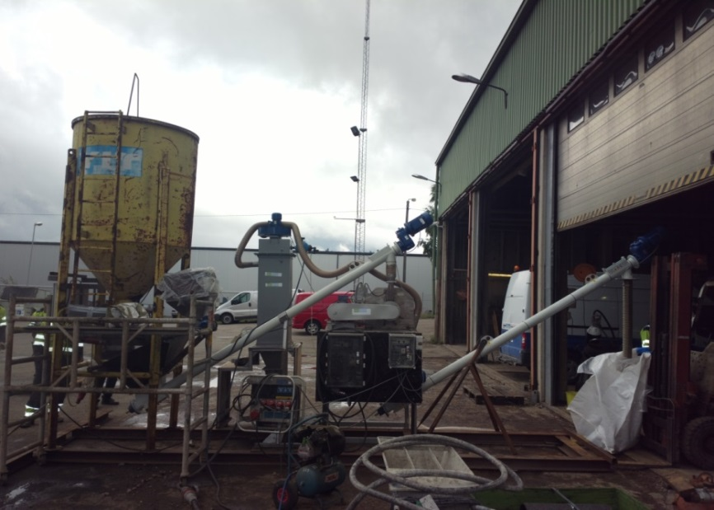
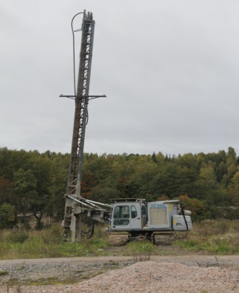
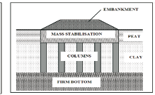
Ash to Soil Construction
Mobile Processing Pilot Unit Based on Mechanical Activation
Ash
800 kg/h
Activation Mill
100-300 kg/m^3 of Binder/m^3 of soil
Cement or Lime
100-200kg/h
CASE Example:
20 000 kg of Ash Processed in 3 effective working days
Ash replaced 80 % of Cement used

Slide 9
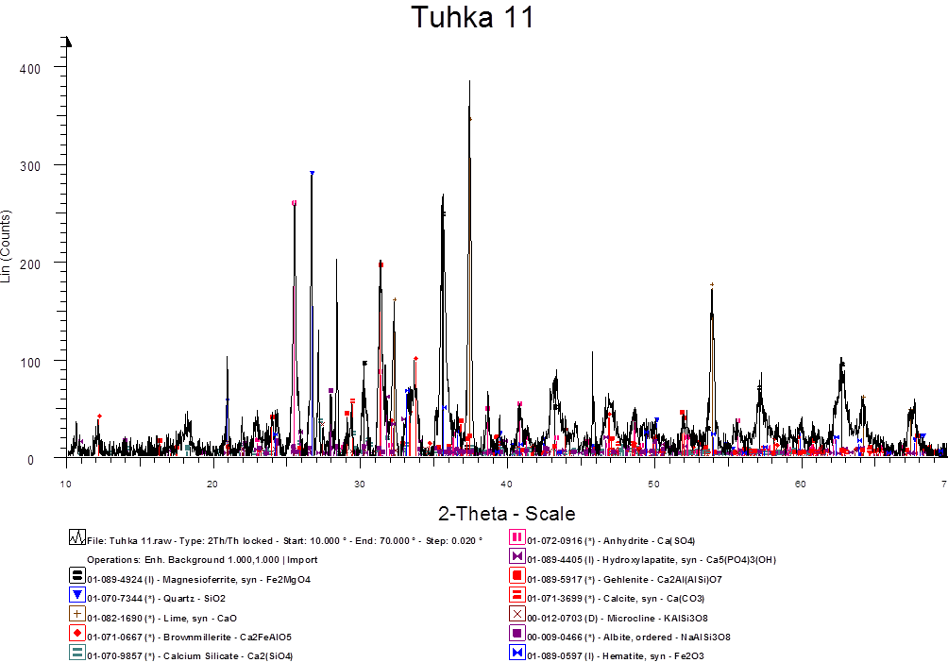
Quality Control System
Composition and Structure
Reactivity
Long time effects and durability

Slide 10
References
PILOTS
Additives in pilot scale CFB 60 kW
Additives in full scale CFB 120 MW (Spring 2015)
Additives in full scale CFB 400 MW (Confirmed Autumn 2016)
Logistic network for Land, Sea and Rails
Cooperation Agreement with Major Construction Company in Finland
Ongoing Discussions with many Plants between 20 – 400 MW CHP-plants.

Slide 11




Ash utilization Network
Ash Chemistry and Modifications
Ash Management
Ash utilization for soil stabilization
Ash to Cash
Ash to Sea Logistics
Ash utilization for soil construction
Ash Producers:
Fortum/ TSE, Jyväskylä Energy, Eesti Energy, Ahlholmens Kraft...

Slide 12


Some of our partners
So far . . .
Contact:
Valter Wigren
R&D Manager
valter@renotech.fi
www.renotech.fi/r-d

Slide 13
The Team
Bob Talling, CEO
Entrepreneur with 30+ years of international experience in chemical engineering, construction materials, insulation and marine businesses of which 21 years as CEO and entrepreneur of Renotech Inc. He is a leading material expert in the field of cement, concrete, alkali activated materials, geopolymers, and use of side streams and waste materials in the circular economy.
Patrycja Piotrowska, High Temp. Engineer
She is an expert in energy conversion with the focus on combustion properties of solid fuels, and has been working with biomass and ash characterization techniques since 2007 evaluating ash related operational problems such as agglomeration, slagging, deposit formation and risk of hot temperature corrosion
Valter Wigren, R&D Manager
Responsible of developing “Ash to Cash” concept together with Bob. He specializes in ash chemistry and mineralogy, with an emphasis on introducing desired properties in ashes. He also develops milling technology and has a deep understanding of the Mechanochemical Activation processes related to high intensity grinding.
Gaurav Das, R&D Engineer
He is working with developing pre-treatment strategies for various industrial waste materials in the power generation and other industries. His studies also involve converting wastes and other side streams of these industries into eco-friendly multi-application oriented high value commercial products, such as Zeolites
Kristian Gunnelius, Laboratory Manager
Kristian is an experienced engineer in the areas of suspension rheology and quantitative XRD analysis. He has been working with semi-adiabatic calorimetry of ash and concrete mixtures. Another strong area of knowledge is the analysis of particle surface properties including zeta potential, surface charge and surface area analysis
Ville-Pekka Johansson, Ash Logistics
Ville is our logistics system planning and logistics cost calculation specialist. As he has experience as an R&D engineer in the fields of resins, colorants and polymers he has a strong background in the chemical industry, including hands-on in​volvement with international technology transfer.

